Slide 1



Paper sharing: Holographic Embeddings of Knowledge Graphs
Speaker :Ying Jie

Slide 2

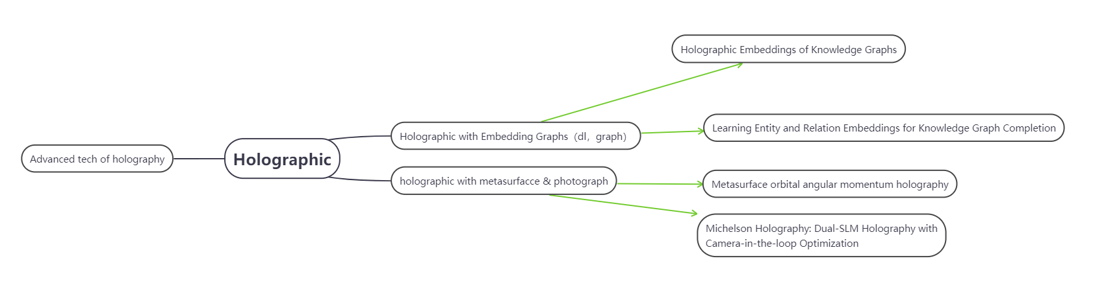
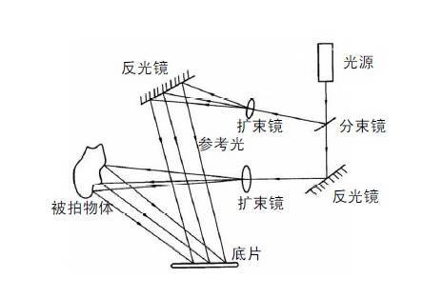
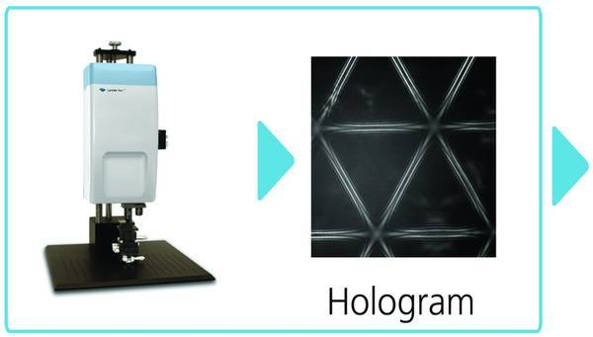
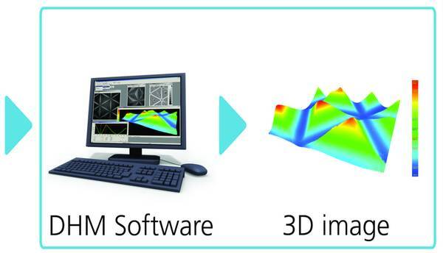
My process of selecting and reading papers in this week

Slide 3
Background Knowledge
1. Knowledge map
2. Tensor product,Concatenation, Projection, and Non-Linearity
3. Embedding of entity

Slide 4
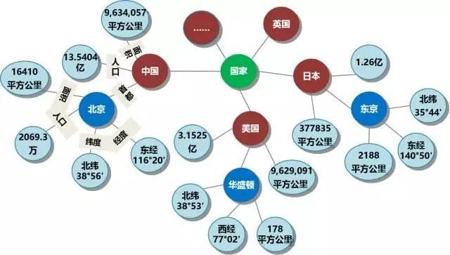
What is a Knowledge map?
（Entity)-（Relationship）-（Entity）
(head, relation, tail)
Triple
fact

Slide 5
Knowledge map’s application
1. Connection to predict
Predict”?” in (? ,r,t)and (h,r,?).
For example, (? Director, Psycho), is the director of the prediction movie, (Venom, director?) "Is to predict that a certain movie will be directed by a certain person. This is essentially a knowledge graph refinement task.
2. Recommendation system
Three types of information stored in the KG are used to derive semantic representations of items, including structured knowledge (triples), textual knowledge (for example, a text summary of a book or movie), and visual knowledge (for example, a book cover or a movie poster image).

Slide 6
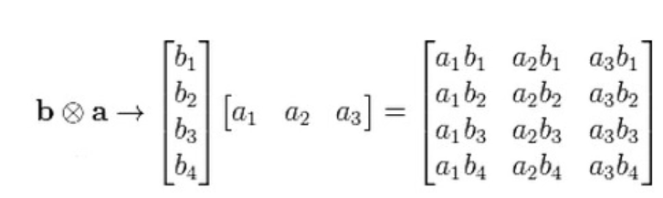
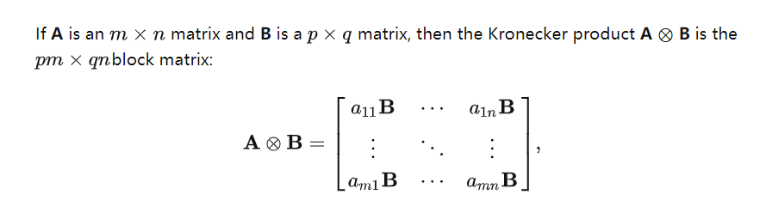
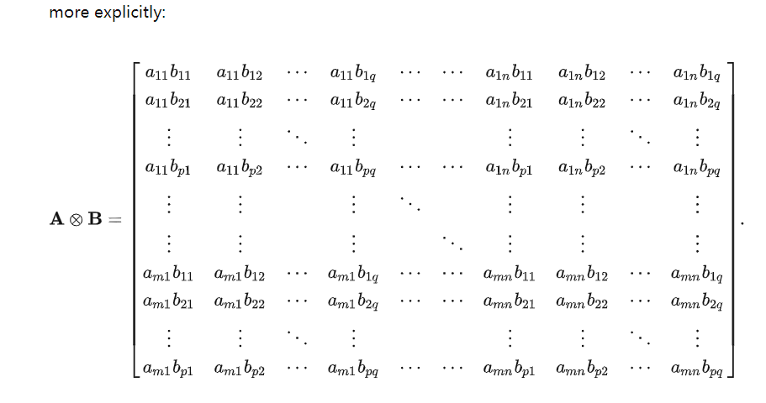
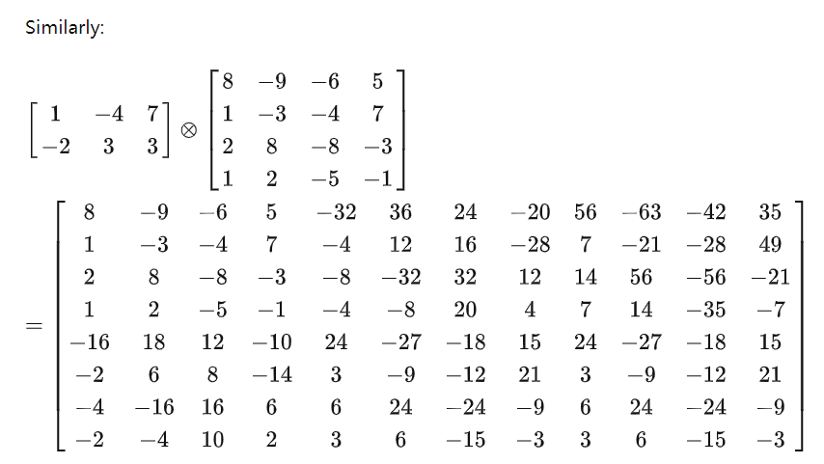
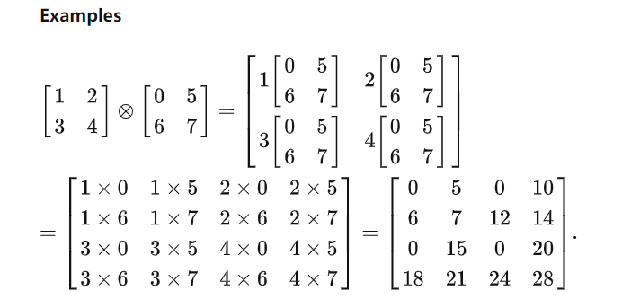
Tensor product

Slide 7



Concatenation, Projection, and Non-Linearity
⊕ means series, and ψ can be a nonlinear function, like tanh. The combined tuple is represented as a◦ B =ψ(W(A ⊕ B))
The projection matrix W is learned by combining entity and relation embeddings.
A feature W (A ⊕ B) in a tuple representation is ON if at least one of the corresponding functions is in the ON state. The advantage is that the matrix W adaptively learns the mapping from entity embeddings to pairwise representations. However, the resulting composite representations are also less rich because they do not consider the direct interaction of features.

Slide 8
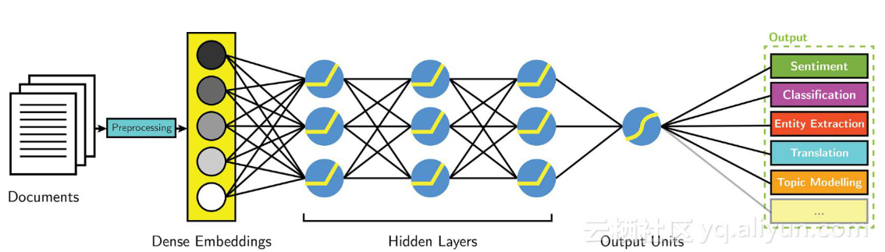
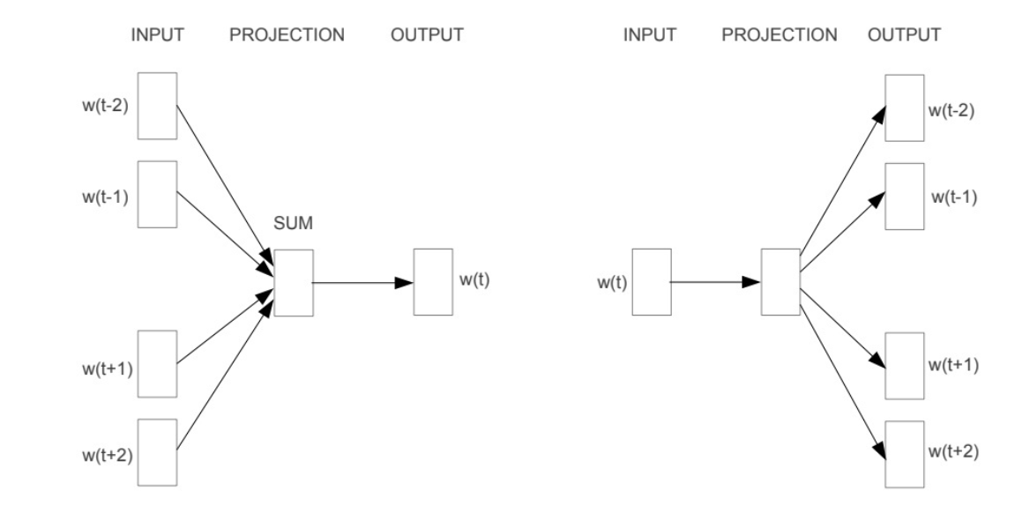
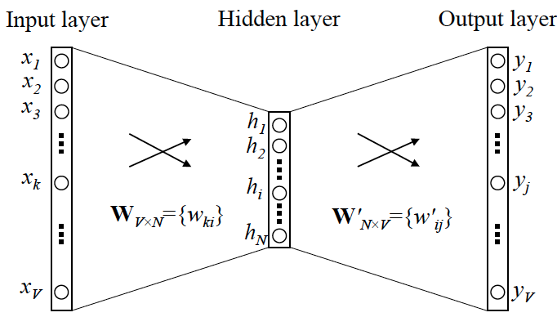
Embedding of entity
The concept of entity embedding originated in a paper called Word2Vec, which basically translates the contents of an article into a vector
CBOW
Skip - gram

Slide 9

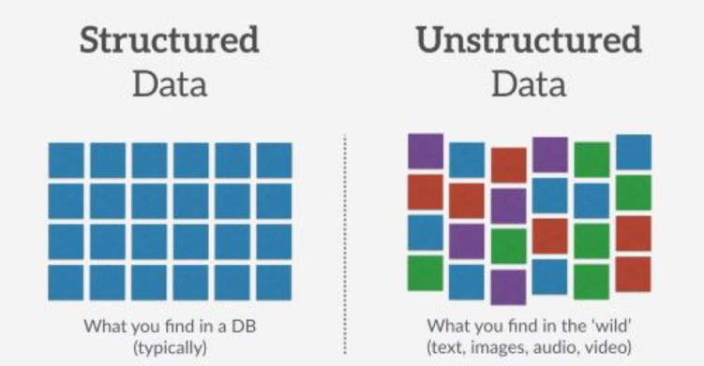

Embedding of entity（实体嵌入）
How do you handle categorical variables in a data set ?
1. One-hot encoding
2. Label encoding
Advantages of Embedding

Slide 10
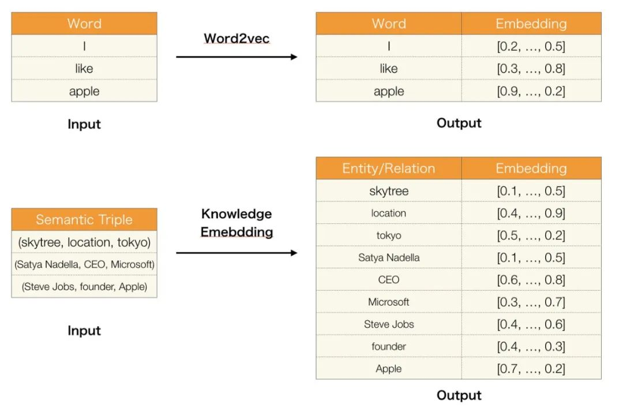
Some models before we learn HOLE
1. Word2vec
Typically, triples (head, relation, tail) are used to represent knowledge.
For example, (Sky Tree, location, Tokyo). We can represent this in terms of a unique heat vector.
But there are too many entities and relationships. When two entities or relations are close, the singleton vector cannot capture the similarity.

Slide 11
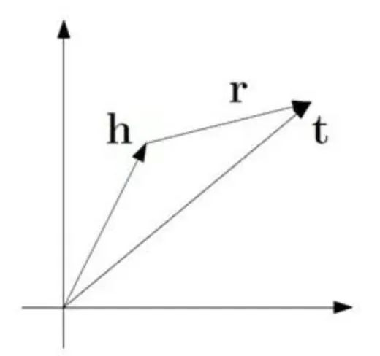

Some models before we learn HOLE
2. TransE（Translating Embeddings for Modeling Multi-relational Data）
Max-margin function with negative sampling is used:
L(y, y’) = max(0, margin - y + y’)

Slide 12
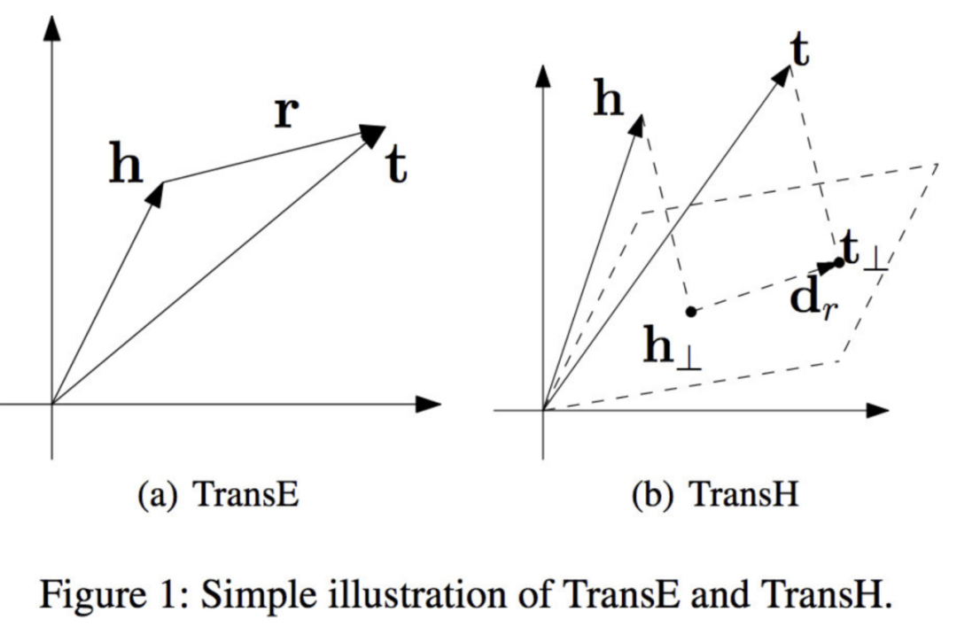





Some models before we learn HOLE
3. TransH（Knowledge Graph Embedding by Translating on Hyperplanes）

Slide 13
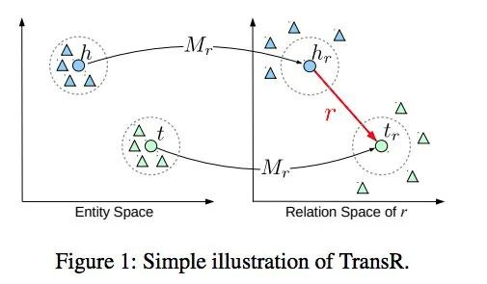



Some models before we learn HOLE
4. TransR（Learning Entity and Relation Embeddings for Knowledge Graph Completion）

Slide 14
Compared with TranseH & TranseR，where to improve？
Something needs to be improved：
A major attraction of TRANSE is that it requires few parameters and is easy to train. However, this simplicity comes at the cost of modeling capabilities
TRANSH and TRANSR to improve the performance of TRANSE on 1-to-N, n-to-1 and n-to-N relationships. Unfortunately, these models lose the simplicity and efficiency of TRANSE.

Slide 15
Holographic Embeddings of Knowledge Graphs
# Paper Abstract：
1. Provenance：AAAI 2016
2. Author：Maximilian Nickel and Lorenzo Rosasco and Tomaso Poggio
3. Cites：1k+ （According to incomplete statistics）
Task:
1. Holographic embeddings (HOLE) are proposed to learn the whole knowledge graph composition vector space representation.
2. Study the problem of learning from knowledge graph within the framework of combined vector space model.
Experiment:
The results of Transe, Rescal, ER-MLP and other models in the prediction of national data are compared

Slide 16
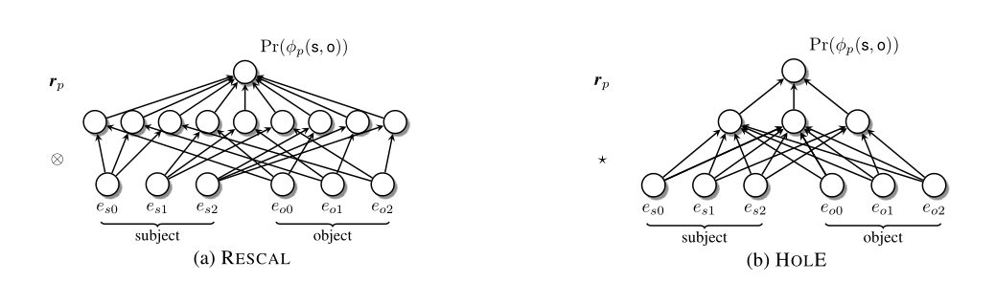
HOLE conceptual graph
RESCAL method and HOLE method comparison:
The former has d^2 middle layers, while the latter has D middle layers

Slide 17











The meaning of some symbols
一个域中所有实体的集合
二元关系，表示所有实体对
表示每一对可能的实体是否属于Rp
可能的一对实例关系
指关系
指实例
s，o均为集合中的实例
表示所有嵌入的集合
表示嵌入一对的（s，o）复合向量
表示一个三元组
表示一个标签
表示实例对数据集
η j > 0：指定边距的宽度。

Slide 18

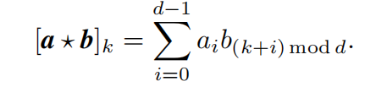


The meaning of some symbols
张量积
串联，表示拼接
表示非线性函数，例如tanh
表示投影矩阵，结合实体嵌入和关系嵌入得到
表示循环相关
存在的三元组和不存在的三元组
表示指定边缘的宽度

Slide 19
Three procedure of a Tensor-product model
1. Combined vector space model
2. Achieve representation of entities and relationships that best explain the dataset by minimizing (regularizing) logistic losses
3. Pairwise Ranking Loss can be used when KGs only stores correct triples

Slide 20
Procedure 1：compositional vector space models
1. Combined vector space model
It allows a learning task to be transformed into a supervised representation learning problem
Indicates whether each pair of possible entities belongs to the Rp
The set of all relationships
◦ : Composition operator that creates a composite vector representation of (S, O) (S, O) (S, O) from the embedded ES and EO.

Slide 21
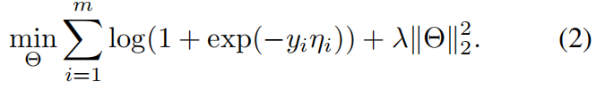
Procedure 2：reduce logic loss to implement data set and entity relationships
For relational data, minimizing logistic losses has the added advantage of helping to find low-dimensional embeddings for complex relational patterns.

Slide 22

Procedure 3：pairwise ranking loss
For example, rank the probability of an existing triplet as higher than the probability of no triplet.
D +, D − : represents the set of triples that exist and do not exist.
η j > 0: specifies the width of the margin.

Slide 23
Means of HOLE
Methods:
Represent both entities and relations as vectors. Given a fact (H, R,t)(H,r,t)(H,r,t), the entity representation is first composed using loop correlation operations
H ∗t∈R H *t∈Rh∗t∈R.
The combined vector is then matched to the relational representation to score the facts.

Slide 24



Model & Formula of HOLE
1. Composition operator:
2. Probabilistic model of triples:
3. SGD algorithm:

Slide 25
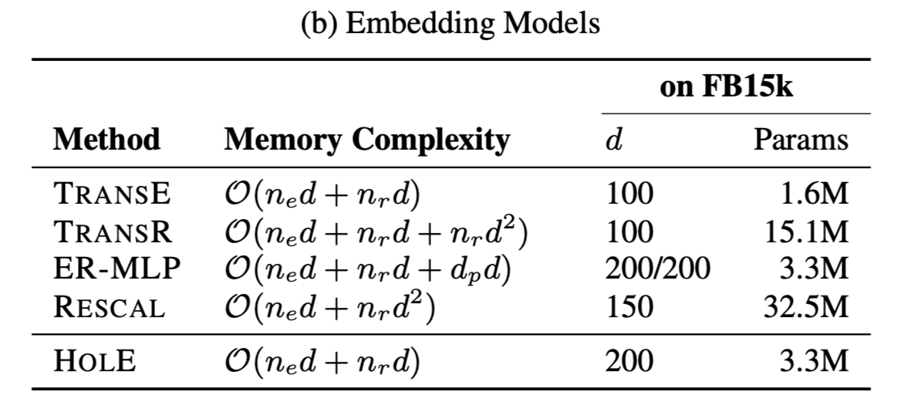
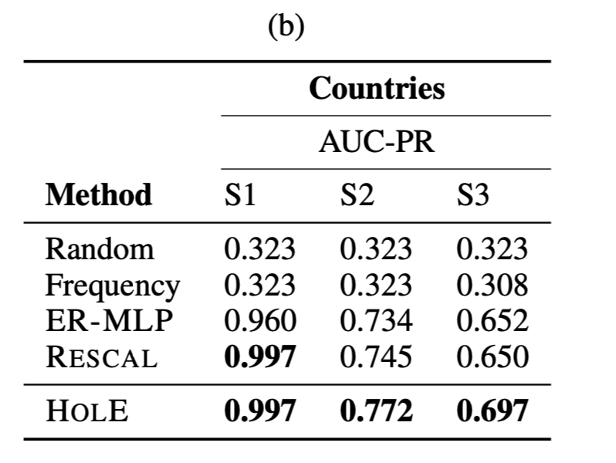
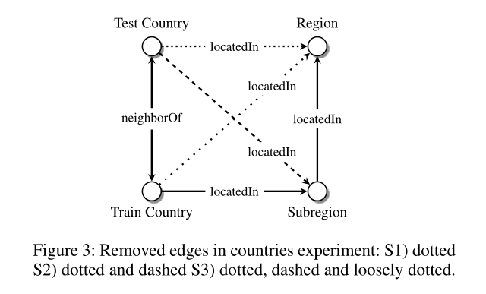
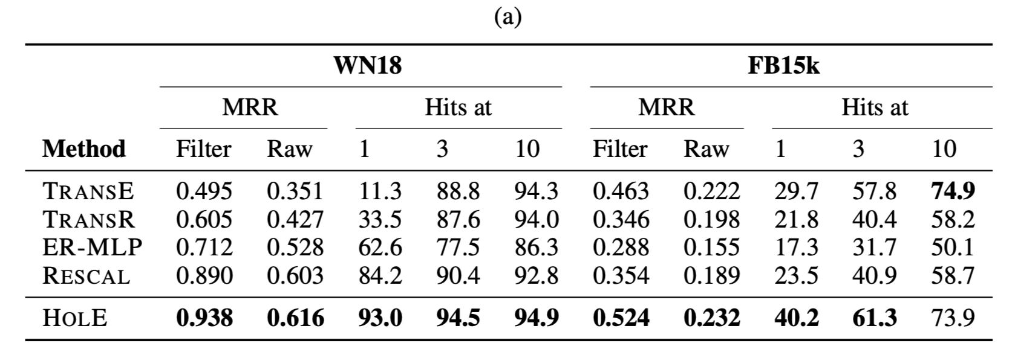
Outcome of HOLE experiment
To be fair, the same loss and optimization methods are used to retrain the models participating in the comparison.
采用数据集：WN18，FB15K

Slide 26
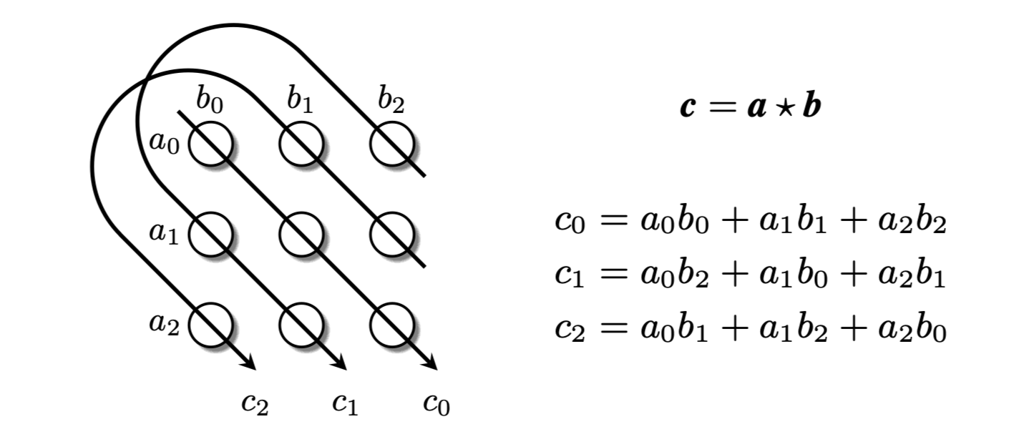
Conclusions and Reflections

Slide 27
Conclusions and Reflections
Advantages of cycles over tensor products:
1. Compared with tensor products, cyclic correlation has the important advantage of not increasing the dimension of the composite representation.
2. The space complexity is linear in dimension D of the entity representation, and the runtime complexity is log-linear in D. It has a significant impact on the number of overall parameters and operation efficiency.
3. A combined representation has the same dimension as its constituent representation.

